Slide 1
Our Programme
Workshop 2 “Discover”
How to understand the problem
Workshop 3
“Define”
How to define your project
Workshop 4
“Develop”
How to come up with shared solutions
Workshop 5
“Test”
How to test if those solutions are right

Slide 2
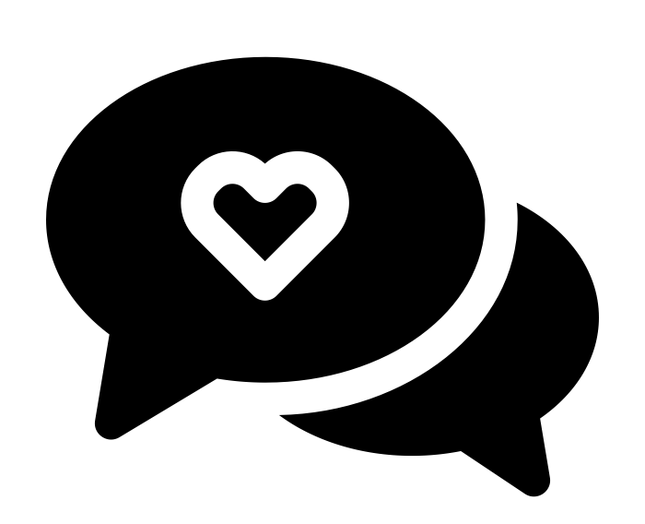
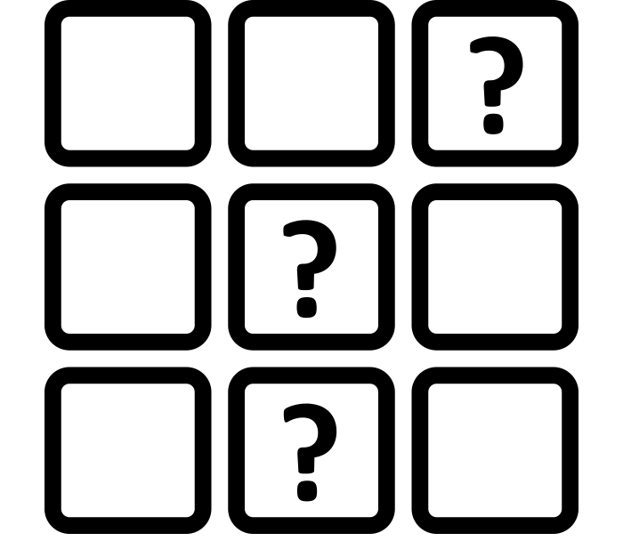
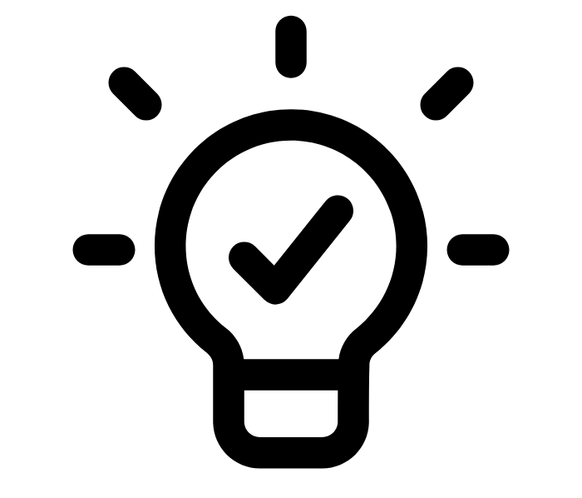
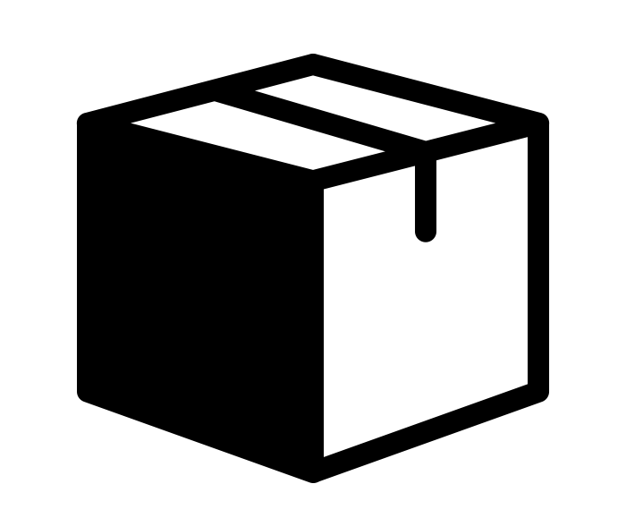
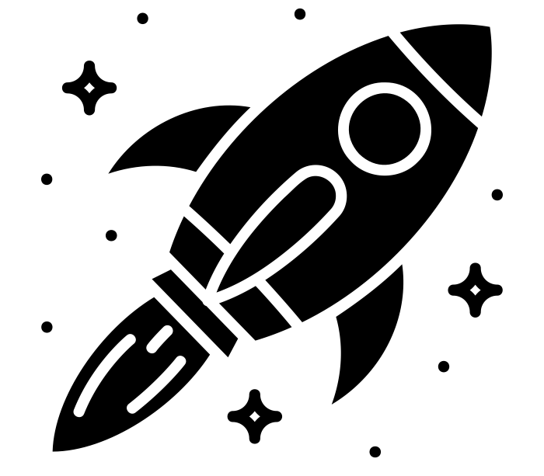
An example plan making process
Set up and discover
Generate ideas
Test and deliver
Define
Develop
Collate what you already know and run 2 to 3 sessions with groups identified as priorities to broaden outreach. | Use all this to identify key 3 to 5 themes/topics and create and 3 “how might we” questions per topic. Go back to participants to sense check. | Run community events to generate ideas around these questions, landing on around 3 to 5 project ideas per question. | Develop ideas further and bring the plan together with your working group. | Go back out and test the plan, get buy in, find people who can make it happen.

Slide 3
The Co-design Planning Canvas
Name. . . . . . . . . . . . . . . . . . . . . . . Stage. . . . . . . . . . . . . . . . . . . . . . . . . . . . .
1. WHY?… [What is the purpose of this stage?]
5. WHAT DOES SUCCESS LOOK LIKE?... [What would be a great outcome? How do we know its been successful?]
2. WHO?… [Who are we hoping to work with? How will we reach them?]
3. WHAT?… [What activities might we deliver? What methods might we use?]
6. TOP TIPS… [What do we need to remember to ensure good co-design?]
4. WHEN AND WHERE?… [What are the timeframes? Where might we host this event?]

Slide 4
Alex Quattrone
Set up and discover
The Co-design Planning Canvas
Name. . . . . . . . . . . . . . . . . . . . . . . Stage. . . . . . . . . . . . . . . . . . . . . . . . . . . . .
1. WHY?… [What is the purpose of this stage?]
5. WHAT DOES SUCCESS LOOK LIKE?... [What would be a great outcome? How do we know its been successful?]
The purpose of this stage is to widen the conversation around what people would love to see in the neighbourhoods, in relation to nature. We’re hoping the stage provides the opportunity to bring a wide range of people in the room to have lots of conversations, ones that really broaden our understanding of this topic. This will help kick start our process and ensure the ideas we create later down the line are representative of what the community care about.
If we are able to broaden the conversation around nature and get a real diversity of people to chat and build connections, that will be a big win for us. We know that we will be successful when we are surprised by what we hear and genuinely feel like the conversation has been stretched beyond what we already know.
2. WHO?… [Who are we hoping to work with? How will we reach them?]
3. WHAT?… [What activities might we deliver? What methods might we use?]
We’re hoping to engage a diverse range of the community and hopefully bring in decision makers too. In particular, we know that the voices of some groups have historically not been listened to as much - such as those with disabilities, the local Bangladeshi community and local small business owners. We will make a targeted effort to include these people by reaching out to local groups in the area that have strong connections to these people. We will ensure the first event is able to meet the needs of these groups and is a safe and welcoming space, by asking them directly what will encourage their participation. We hope by doing this we will attract a good diversity of people.
We use this stage to be able to hold wide ranging conversations that enable different people to learn and build from each other. As such, we will hold our main event using the world cafe method, where there are multiple questions around the theme of nature and a number of tables where people will deliberate. We know that our first event might not capture everything and that not everyone will be able to attend. Therefore, we will also supplement this with deeper one to one interviews, which will help us capture all the diverse viewpoints and also give us the opportunity to delve deeper on particular topics.
In addition, we already have research from previous years that we will use to supplement what we hear. But we will ensure this does not dominate our thinking on the subject.
6. TOP TIPS… [What might we be holding throughout to ensure good co-design?]
Making sure we are taking into account the needs and cater to the needs of different groups to take part in our work, particularly those who we haven’t engaged with before. We will also be holding how to facilitate open dialogue that makes people feel confident to share and listen to one another.
4. WHEN AND WHERE?… [What are the timeframes? Where might we host this event?]
We’re hoping to hold our nature conversations across the month of September 2024 and would love to use our local food growing space as the hub from these conversations to happen.

Slide 5
The Co-design Plan Overview
Name. . . . . . . . . . . . . . . . . . . . . . . . . . . Date . . . . . . . . . . . . . . . . . . . . . . .
[1] Set up and discover
[2] Define
[3] Generate ideas
[4] Develop
[5] Test and deliver
Summary…
Dates and location…

Slide 6
The Co-design Plan Overview
Name. . . . . . . . Date . . . . . . . . . . . . . . . . . . . . . . .
[1] Set up and discover
[2] Define
[3] Generate ideas
[4] Develop
[5] Test and deliver
Dates and location…
December 2024 – Walker Wasters, Walker Workers
July 2024 – Walk and Talk
Aug/Sept 2024 – Management Plan consultation

Slide 7
The Co-design Planning Guidance
[1] Set up and discover
[2] Define
[3] Generate ideas
[4] Develop
[5] Test and deliver
QUESTIONS TO CONSIDER
How might we engage with people lived experience and others in their community?
How might we cast the net wide in terms of the topic of conversation, and not narrow too quickly?
How might we start developing relationship with participants?
How might we leverage our existing networks but also reach people we have not worked with before?
How might we use collaborative methods?
QUESTIONS TO CONSIDER
How might we bring together all of our insights as a team and start to make sense of them?
How might we start drawing meaning, themes and opportunities from our research?
How might we craft the right type of questions that are generative?
How might we come to consensus on what to focus on next that reflects the needs of everyone?
How might we go back and test our findings with people?
QUESTIONS TO CONSIDER
How might we prepare participants to be creative and exploratory in our idea sessions?
How might we generate as many ideas as possible, at speed, and not limit our thinking?
How might we bring a variety of people together to build from each other?
How might we merge and combine ideas where possible?
How might we recognise the value in each idea but decide on the most valuable to take forward?
QUESTIONS TO CONSIDER
How might we explore reflects on the key underlying insights?
How might we expand on the key features of an idea whilst focusing on the core part that makes it unique?
How might we reflect on what why an idea is important to a user and how they might benefit?
How might we be clear on our intended impact?
How might we draw on inspiration from elsewhere to bring ideas to life?
QUESTIONS TO CONSIDER
How might we go back out with our plans and share this with people?
What methods might we use to elicit positive and generative feedback?
How might we start to get buy in for specific projects and demonstrate the case for delivery?
How might we invite stakeholders to take ownership of parts of the plan?
How might we refine our plans based on what we hear?
WHAT DOES GOOD LOOK LIKE?
The start of a broad and wide ranging conversation around nature
Lots of different people having conversations together
Capturing a large amount of rich and intriguing insights, some that may surprise you
WHAT DOES GOOD LOOK LIKE?
Honing down what we have learned into key themes and insights that do justice to the research
Testing and iterating our learnings and questions as we go
Landing on a set of questions that feel specific and broad enough to generate ideas
WHAT DOES GOOD LOOK LIKE?
Safe and open space to be creative without judgement
Lots of ideas on the table, some familiar and some pushing the boundaries
Finding connections between ideas
Building consensus around a set of ideas, that are impactful and answer the question
WHAT DOES GOOD LOOK LIKE?
Well developed ideas that are clear on the unique benefit to users
Ideas that can be summarised in our plans and invite comment / builds from the public
Developing ideas as a team, but continuing to test or work alongside people with lived experience
WHAT DOES GOOD LOOK LIKE?
Wide ranging and generative engagement that develops and improves our plans
Momentum behind the plan and evidence of support
Opportunities for people to take ownership and start working on elements they feel confident to do

